Slide 1

GAMES Form
Presented by THAPA ARJUN

Slide 2
CONTENT
INTRODUCTION
PROPERTIES
SNAPSHOT
HANDLED THE FORM
CONCLUSION

Slide 3
INTRODUCTION
A games form is a form used to collect information about a specific game, such as its name, genre, platform, release date, and rating.
This information can be used to catalog or track games, or to display information about a game on a website or application.
The form typically includes input fields for the user to enter the information, as well as buttons to submit or clear the form.
It can be used for various purposes like adding the game to a database, displaying the game information on a website, or updating the game information in a database.

Slide 4
PROPERTIES
Games Name
Genre
Platform
Release Date
Rating

Slide 5
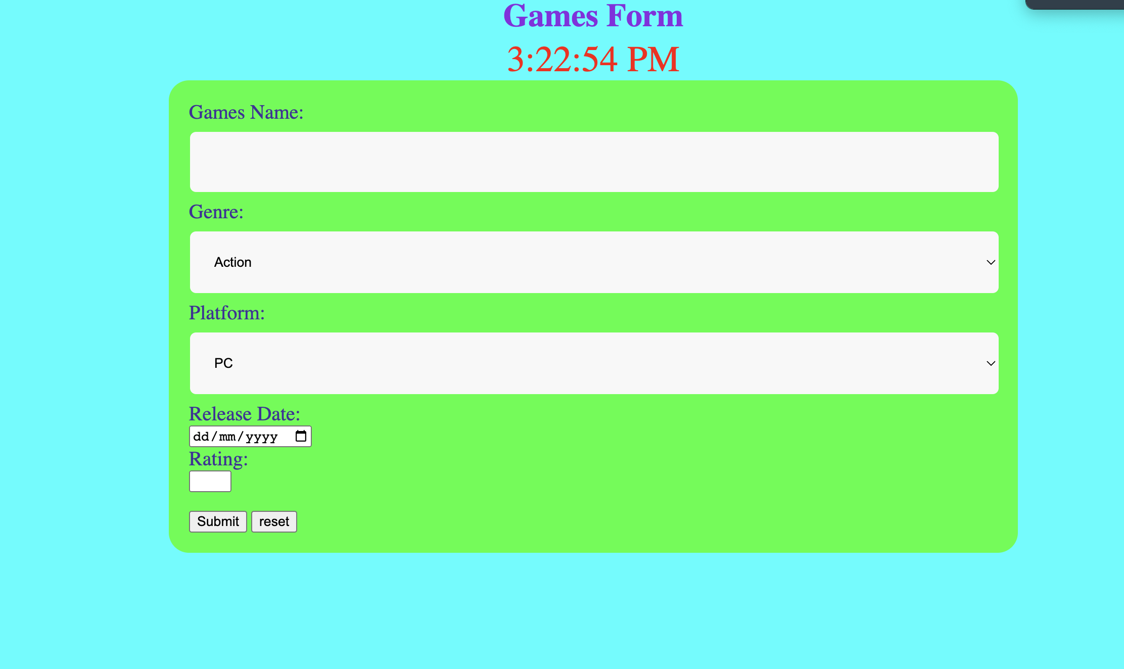
SNAPSHOT
Fig:- form page

Slide 6
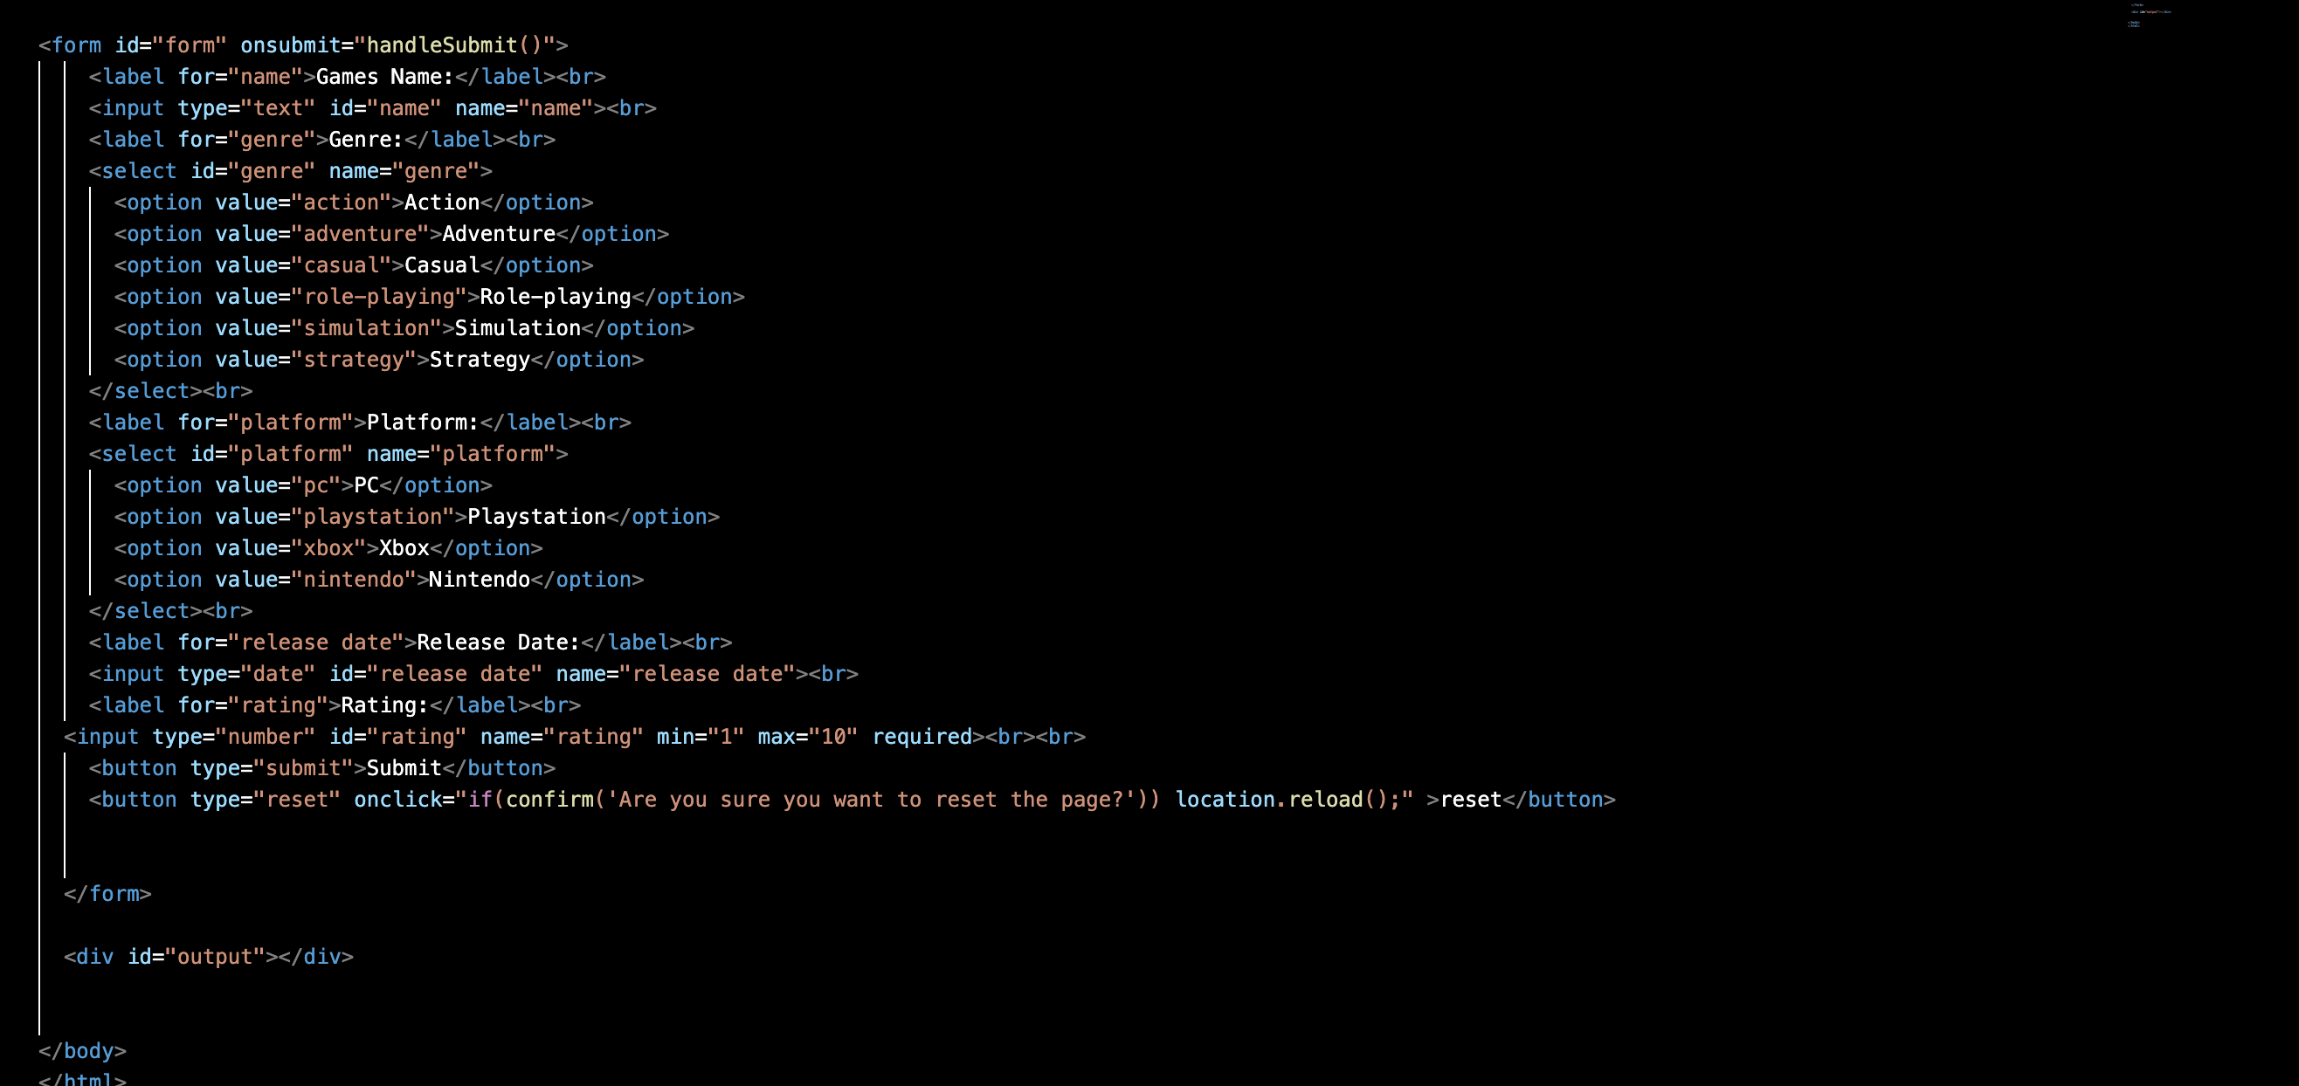
SNAPSHOT
Fig:- HTML

Slide 7
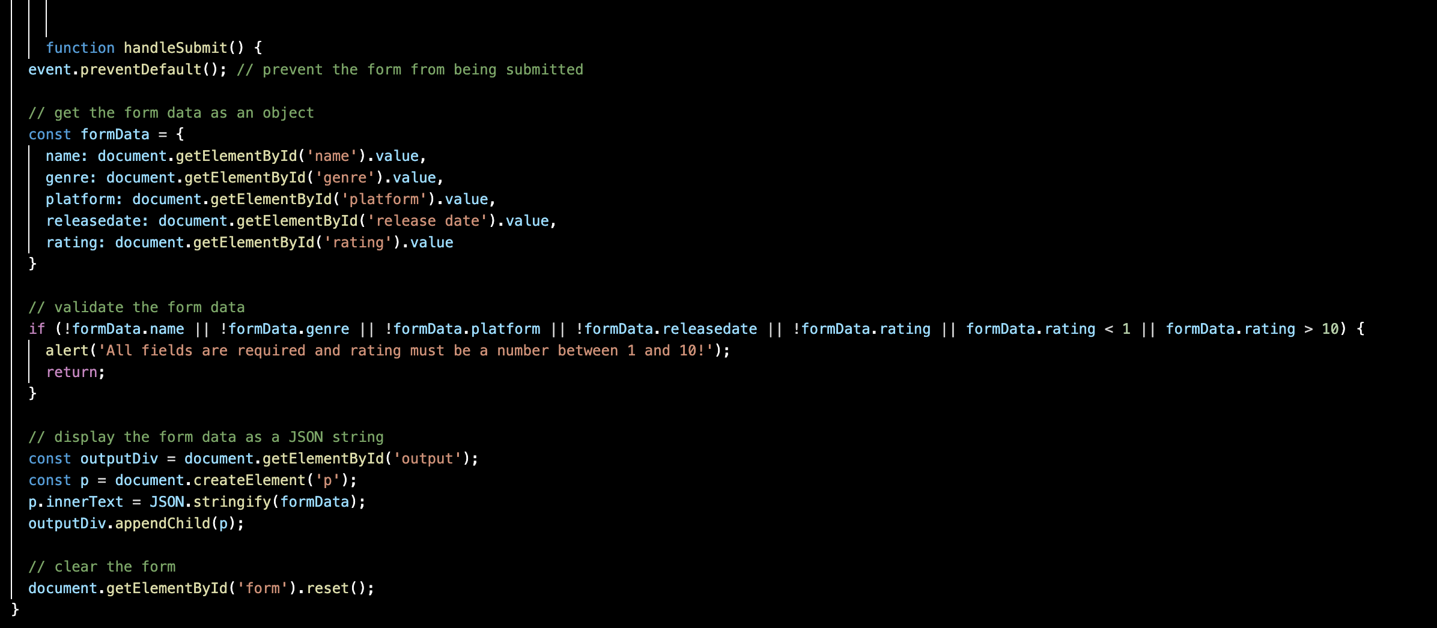
SNAPSHOT
Fig:- javascripts

Slide 8
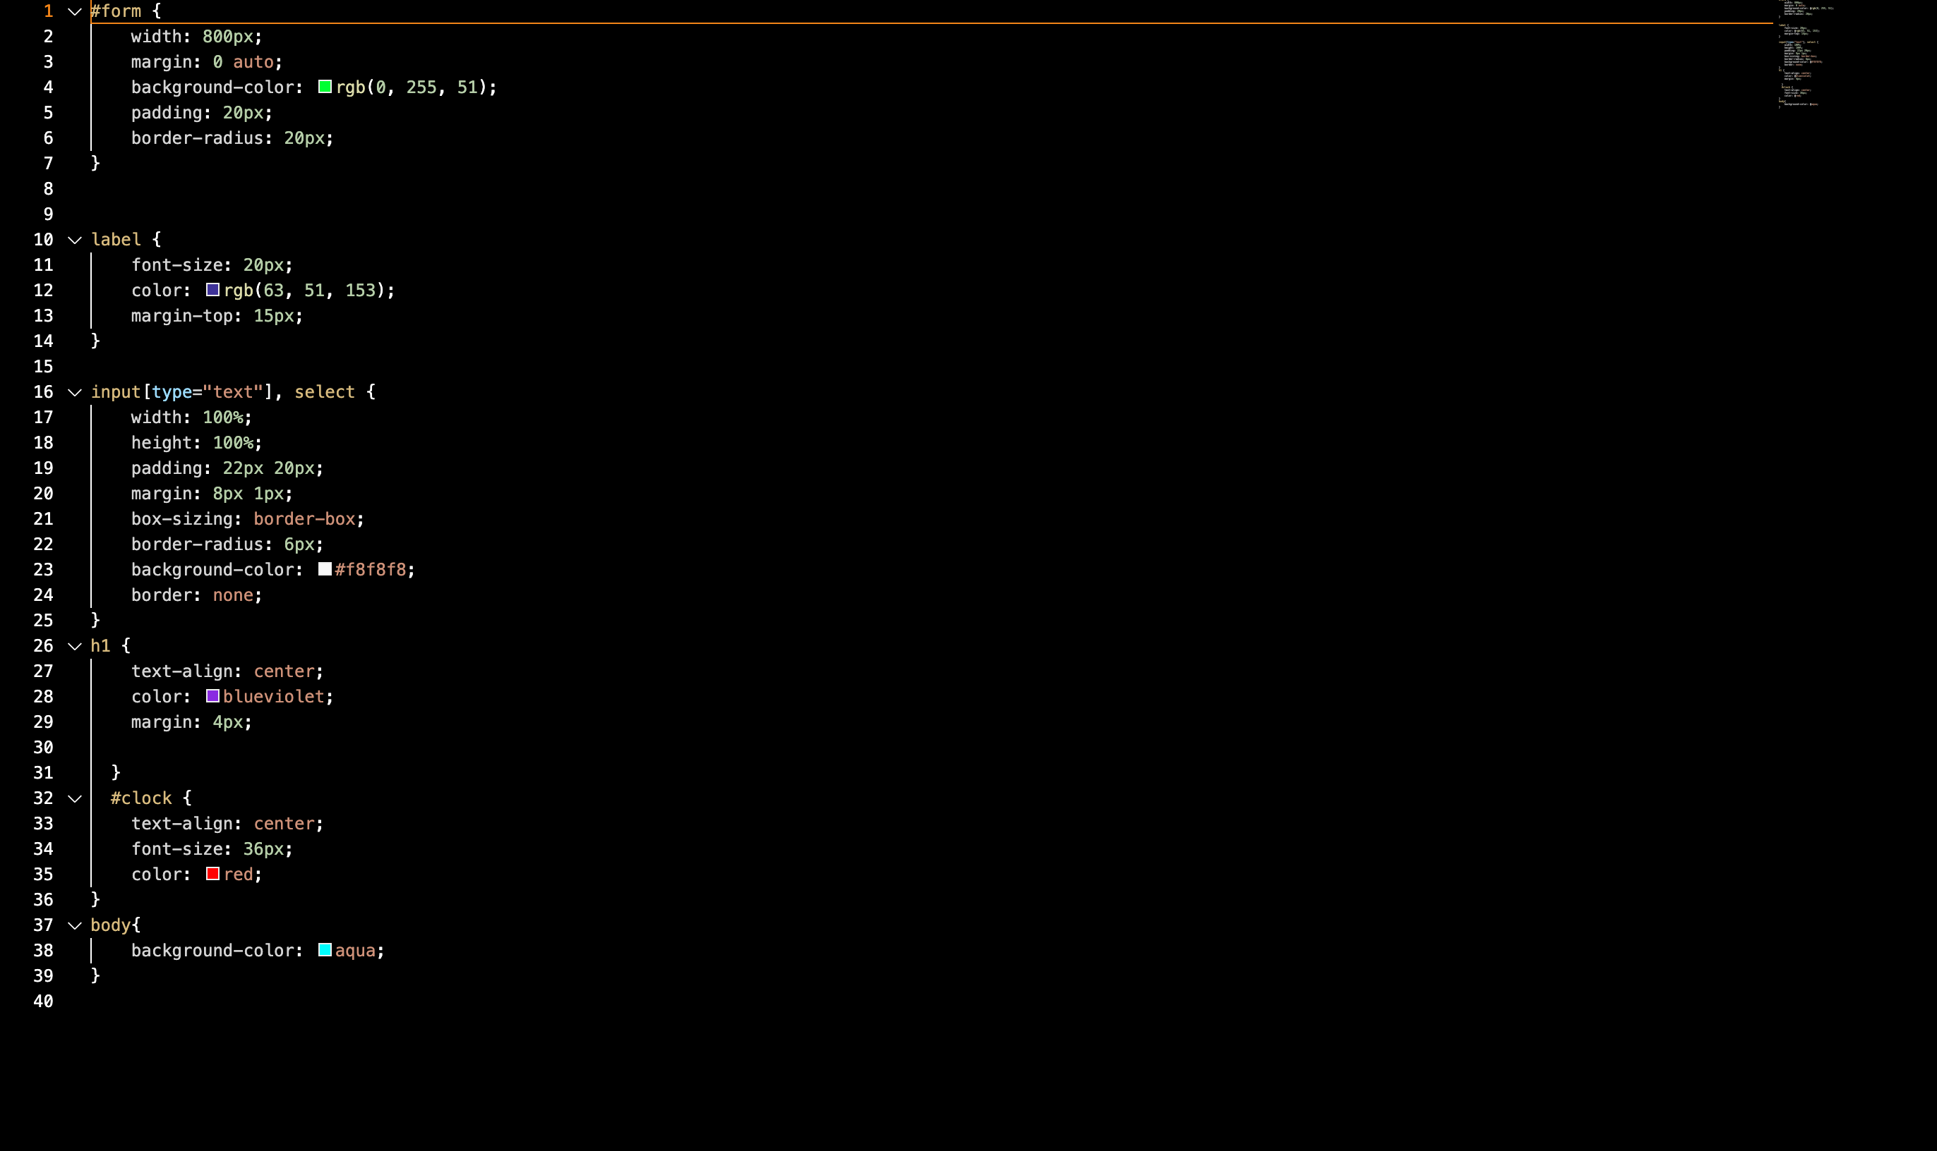
SNAPSHOT
Fig:- CSS

Slide 9
HANDLED THE FORM
The code handles a game form by collecting form data, validating it, displaying it as JSON, and resetting the form. It uses event.preventDefault() to prevent default form submission and document.getElementById('elementId').value to collect form data. It will be check if any of the properties in the "formData" object are empty or undefined and if the rating is less than 1 or greater than 10. After, It will be validated the data and displays it as JSON in a 'p' element, if validation is successful. Finally, it resets the form by calling the reset() method on the form element.

Slide 10
CONCLUSION
In conclusion, a game form is a useful tool for collecting, managing, and displaying information about games. It can be used to add games to a database, display game information on a website, or update game information in a database. With features such as input fields, validation, submit and reset buttons, responsive design, accessibility, security and error handling, a game form can be a powerful tool for managing game information. It can also help to ensure that the information entered is accurate and complete, and that the form is easy to use and accessible to all users.

Slide 11
THANK YOU !

